Slide 2
Power Platform
Walkthrough of Best practices, DevOps & Licenses

Slide 3
POWER PLATFORM
BENEFITS
PROBLEM
Low Code
Self Service
Traceability & Debug
Single developer focus
SOLUTION
Efficient DevOps

Slide 4
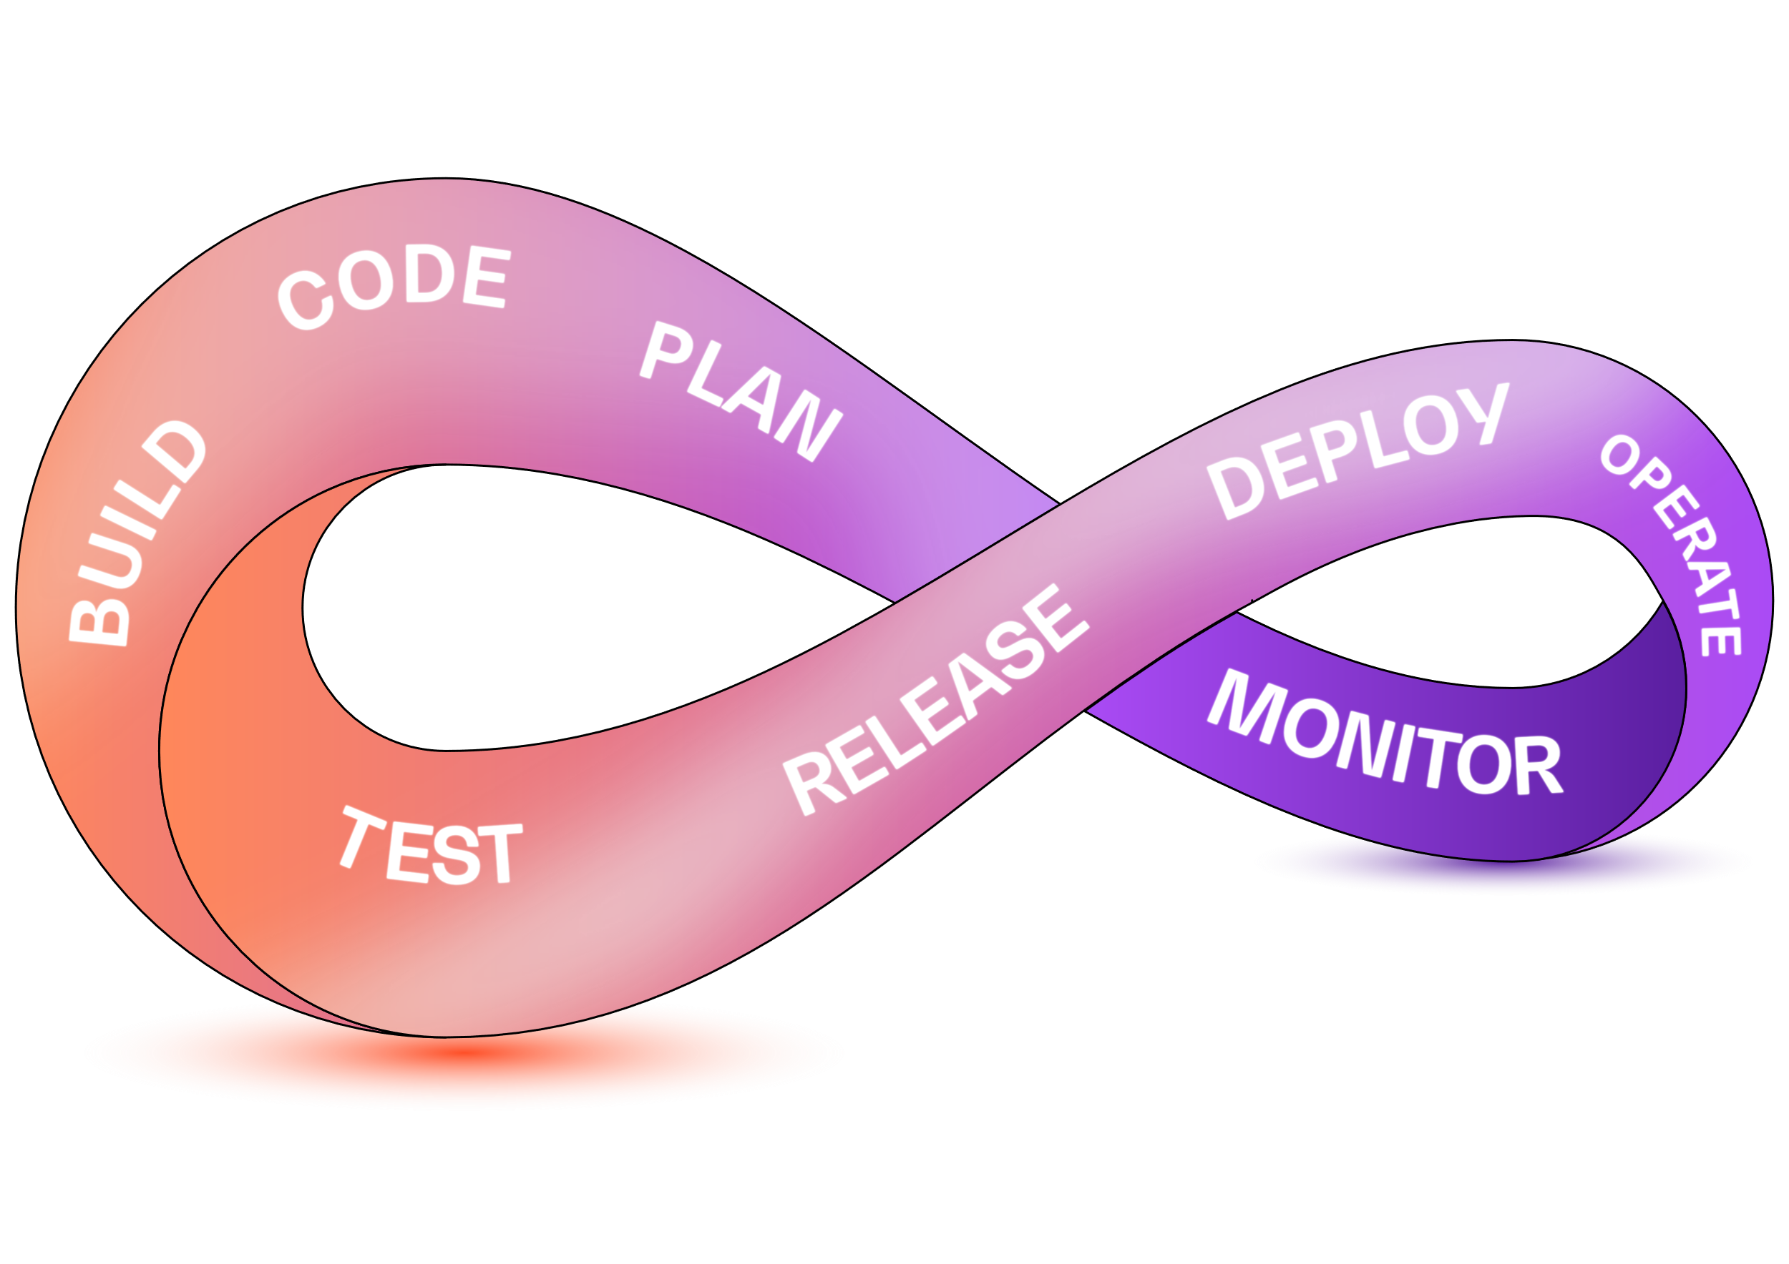
Enviroments & DevOps
Purpose of DevOps
Optimization of flow
Feedback loops
Experimentation
Ways of Work
Version handling
Automated deploy – dev – test – prod
Challenges
Power Platform target group – Self Service
Notes:
Power Apps Portals → Power Pages

Slide 5



DEVOPS IN POWER APPS
Developer 1
code
app code
Test
Azure DevOps
Deployment pipelines
Git
Developer 2
Prod
app code
code
GROWING SUPPORT FOR DEVOPS IN POWER PLATFORM

Slide 6
BENEFITS
Version handling of code
Who did what?
Non blocking collaboration (most parts)
Safer deploy
Faster deploy
Better developer experience
Notes:
Power Apps Portals → Power Pages

Slide 7
POWER APPS LICENCES
Power Apps Premium License (20 $ / user & month)
Unlimited apps, suitable for users that needs access to several apps
Power Apps Per App License (5 $ / user & month)
Access to one single App, suitable for users only needing access to one or two apps
Pay as you go (10 $ / user & month)
Access to Power Apps without fixed licenses

Slide 8
POWER PAGES
Web Portals in the Power Apps way
Can be authenticated and non authenticated
Suitable for external users
Different authentication options (Azure B2C, Google, Linkedin…)
Authenticated Users | Non Authenticated Users
$ 200 per 100 users | $ 75 per 500 users
Power Apps
Power Pages
Different Presentation Layer
Dataverse
Same Data Layer

Slide 9

POWER BI LICENSING
Power BI Pro - $ 10 per user & month
Power BI Premium per user - $ 20 per user & month
Power BI Embedded - $ 735 / month
By using D365 or Sharepoint it’s possible to offer Power BI reports to users without them having Power BI Pro licenses. In these cases the O365 or Sharepoint licenses are used. You still need one Power BI Pro license, for the developer, to publish the Power BI report.

Slide 10

DEVOPS in POWER BI
Power BI Test
Workspace
Developer 1
*.pbip + git
Power BI Prod
Workspace
local repo
Azure DevOps
Git
Developer 2
Power BI Test
Workspace
*.pbip + git
local repo
Power BI Prod
Workspace

Slide 11
POWER BI DEPLOYMENT PIPELINES
The full DevOps experience in Power BI
Automated deployment and version handling
Built into the Power BI service
Requres Premium, Premium per user or Fabric

Slide 12
USE CASE
10 users using Power App with Power BI Dashboard
10 * $ 5 = $ 50 / month Power App Per App License
10 * $ 10 = $ 100 / month Power BI Pro License
Total cost $ 150 per 10 users / month ($ 15 per user & month)
Pay as you go

Slide 13
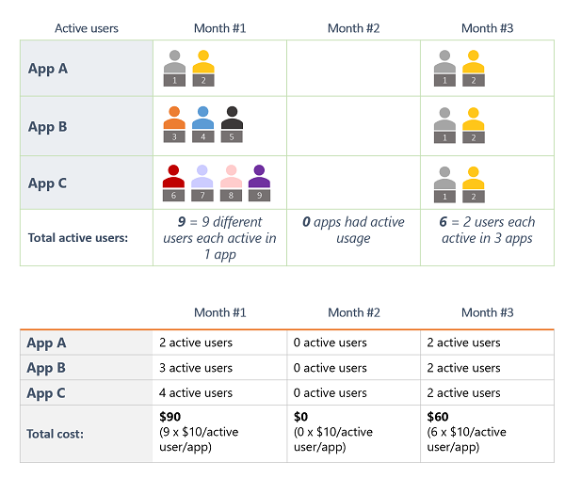
Power ApPS - Pay As You Go
Needs to be investigated and assessed
No license requirement for Power Apps
Cost control can be a challenge

Slide 14
Questions & Discussion

